Slide 1
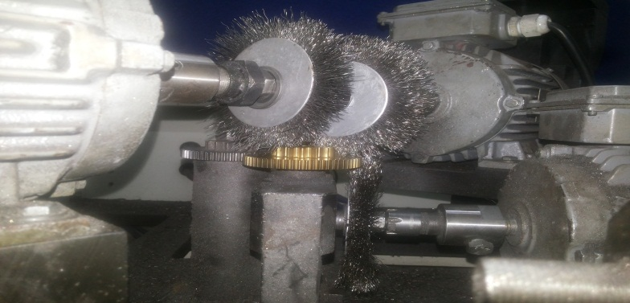
P15
KAIZEN NO :- 10
ACTIVITY
KK
QM
PM
JH
SHE
OT
DM
E&T
KAIZEN IDEA SHEET
TPM CIRCLE NAME: Achiever
LOSS NO. / STEP
DEPT :- MACHINE SHOP
RESULT AREA
P
Q
A,B,C
C
D
S
M
CELL:- D/C
CELL NAME:- DRUM CHANGE
MACHINE / STAGE :- Debarring Machine
OPERATION :- DEBBARRING
KAIZEN THEME :To reduce gear cost
IDEA :- Hard Material Gear to be Use.
Problem / Present Status :- A425 Debarring machine rotation gear wear out in 63000 nos.
COUNTERMEASURE:-
A425 Sintered Gear Used for Wheel Rotation to Avoid wear &Tear.
BENCHMARK
Less Life
TARGET
Life Improved
KAIZEN START
03.05.2016
KAIZEN FINISH
04.05.2016
TEAM MEMBERS : 1. Someshwar Salunkhe. 2. Amol Patil
BENEFITS :-
Rotation Gear Cost Saved.
KAIZEN SUSTENANCE
After
WHAT TO DO :- Use Only Metallic Gear
HOW TO DO :- Design to be Approved by ME.
WHY - WHY ANALYSIS :-
Why1 :- A425 Rotation gear less Life (63000nos).
Why2:- Rotation Gear wear out .
Why3:- Gear Material Soft Used i.e.( Fiber).
RESULT :-
Rotation gear life improve.
.
ROOT CAUSE:- Gear Material Soft Used i.e. ( Fiber).
REGISTRATION NO. & DATE : 04.05.2016
SCOPE & PLAN FOR HORIZONTAL DEPLOYMENT
REGISTERED BY :- Someshwar Salunkhe
SR.
NO.
CELL
TARGET
RESPONSIBILITY
STATUS
MANAGER’S SIGN :- D. Y. Pawar
1
----
---------
-----

